Slide 1
War and its Infectious Implications
Infectious Disease Surveillance in the Context of Conflict in Syrian
Sammy Mehtar
UC Berkeley – UCSF
Joint Medical Program
Notes:
7 years, 11 months, 1 week, 4 days
Have one narrative: only one question.
Include other questions in the future steps slide
Maps need no titles journey is important
Confused on pyramid slide:
Cut the bullets
Emphasize that it happens every week
Build pyramid step by step
No acronyms
How to frame the incidence vs counts
Explain political maps better
Journey is good
Two stories:
The conflict and its impact
The measles
Do not be ashamed about negative findings
Hospital bombings do not predict
Daesh did predict measles
Human rights on access to health
More structural determinents
Lot more going on: this stsructural issue of access to resources (Daesh)
Hospital bombings have other impacts that may not be masured acutely, as much as Daesh.

Slide 2
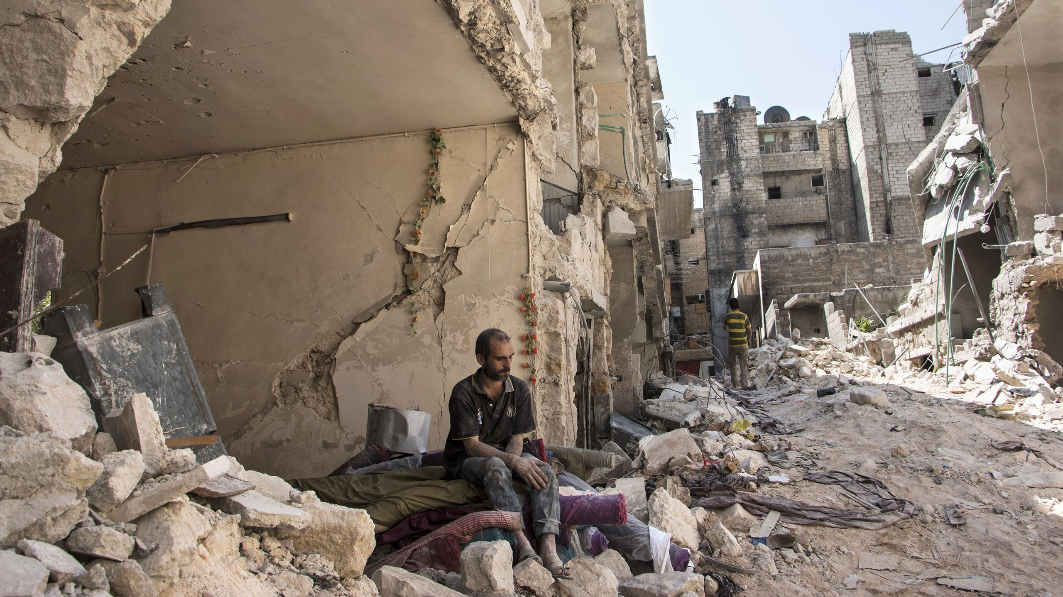
The war in Syria
March 2011: Anti-government protests began in the context of the Arab Spring
Clashes escalate to conflict, factions develop
Conflict becomes entangled in a global web of geopolitical maneuvering
Death toll of conflict is immense
>5.6 million refugees, >6.6 million internally displaced persons (UNHCR)
Prewar Population: ~22 million, Current Population Estimates: ~18 million
Courtesy of NYT
Notes:
Became grounds for a proxy war between nations
With the Syrian people caught in the middle
As collateral damage
This is not happening in a vacuum
There are consequences for public health in the region
Sent me on a search for what I can use my masters to contribute towards?

Slide 3
Research Question(s)
How has the epidemiology of measles changed throughout the course of the war?
Descriptive analysis of surveillance data
How have attacks on healthcare impacted infectious disease trends?
Ecological association between infectious disease incidence and documented attacks on healthcare facilities
Courtesy of NYT

Slide 4
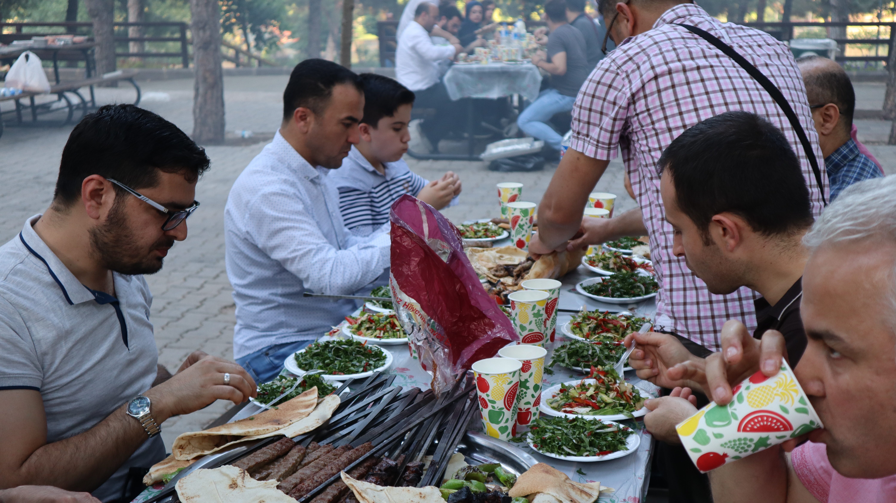
Notes:
One of the perks of staying in Turkey
Take their bbq very seriously
Beautiful views, great food, great company

Slide 5
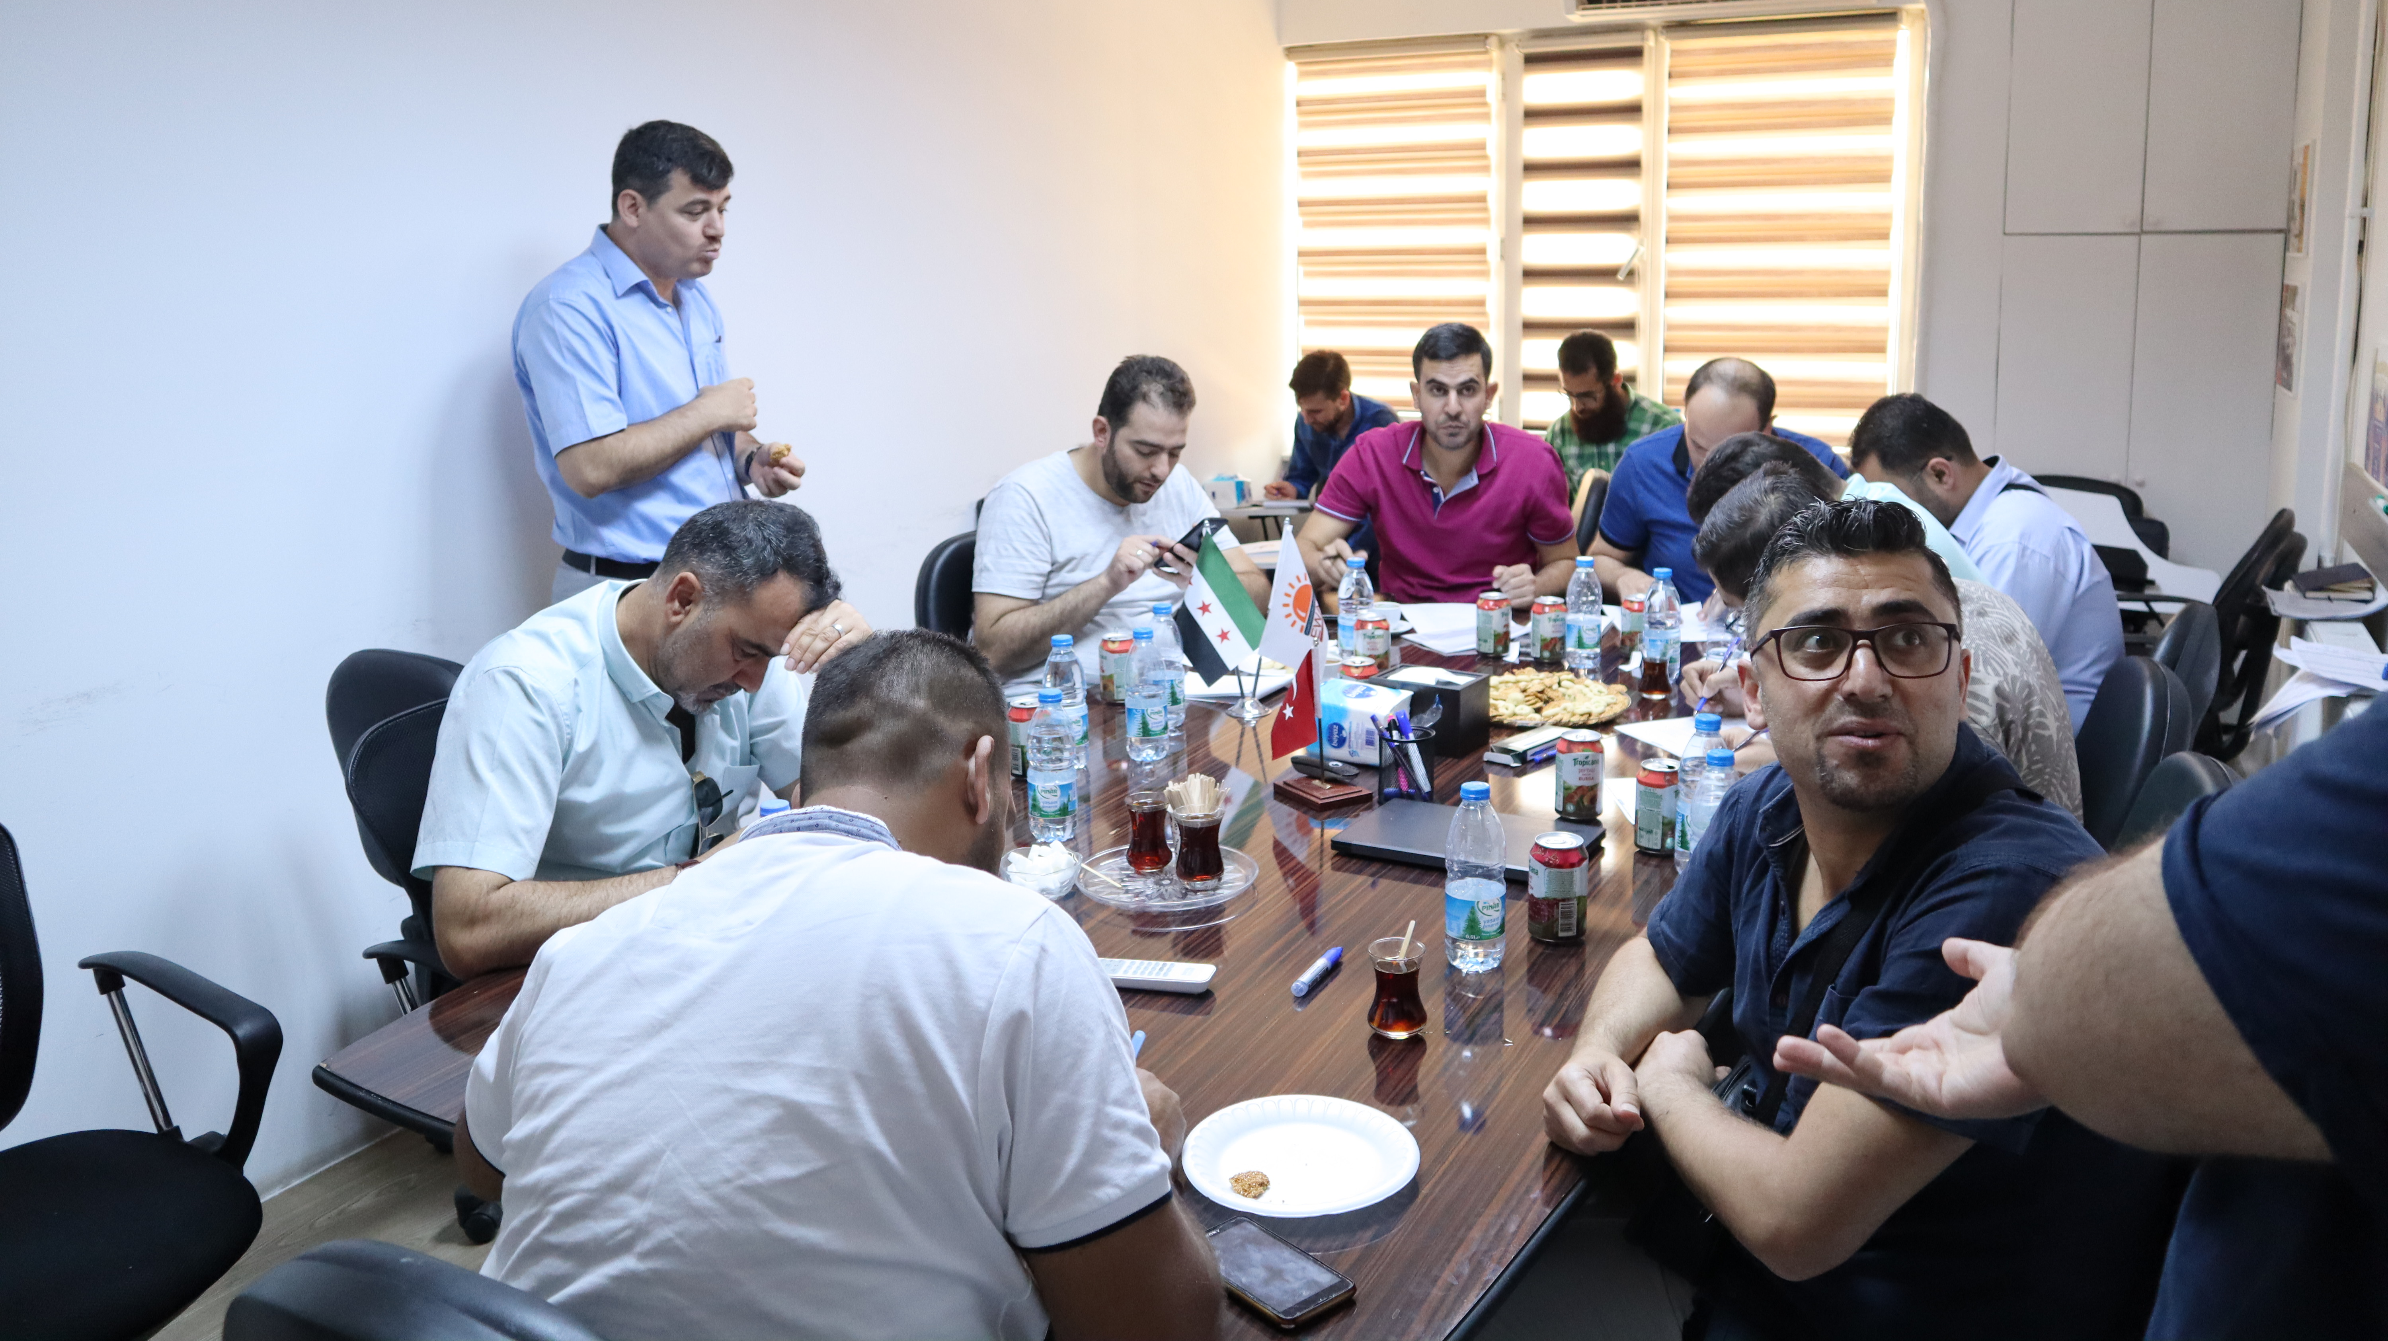
Notes:
And familiar scenes: PBL with the ever-present Turkish Tea
Worked with the ACU, which has a branch that operates an infectious disease surveillance program.
Started by Syrian physicians escaping scenes such as this:

Slide 6
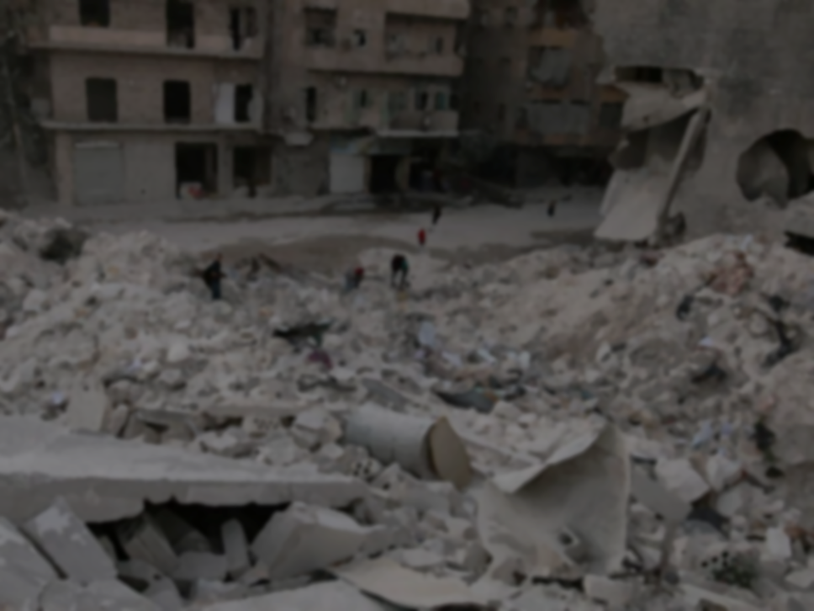
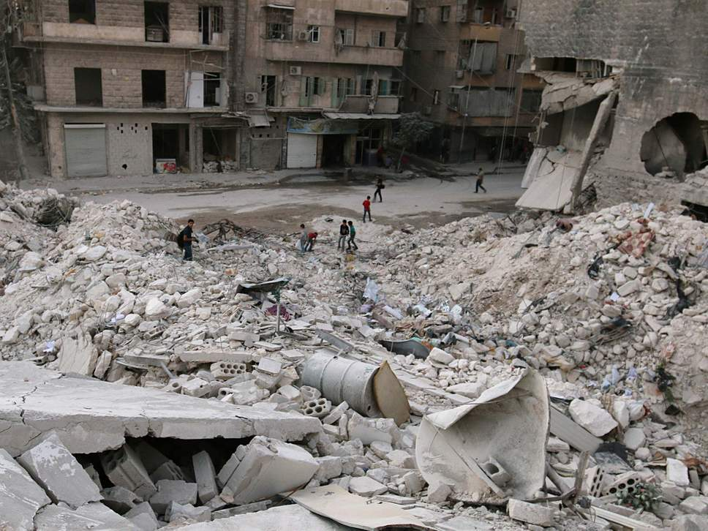
Omar ibn Abdul Aziz Hospital (AKA M2) in Aleppo, Syria
Al-Jazeera
Notes:
How did we get here?

Slide 7
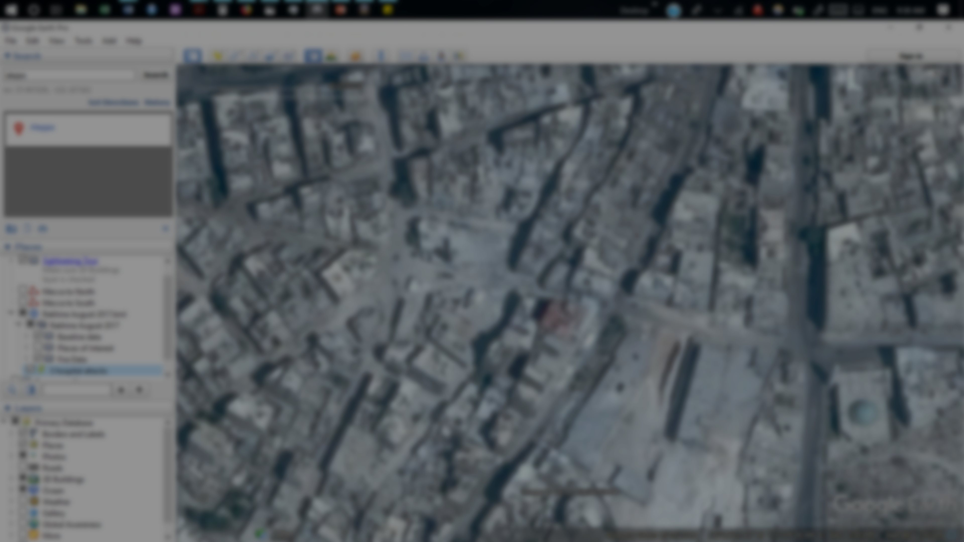
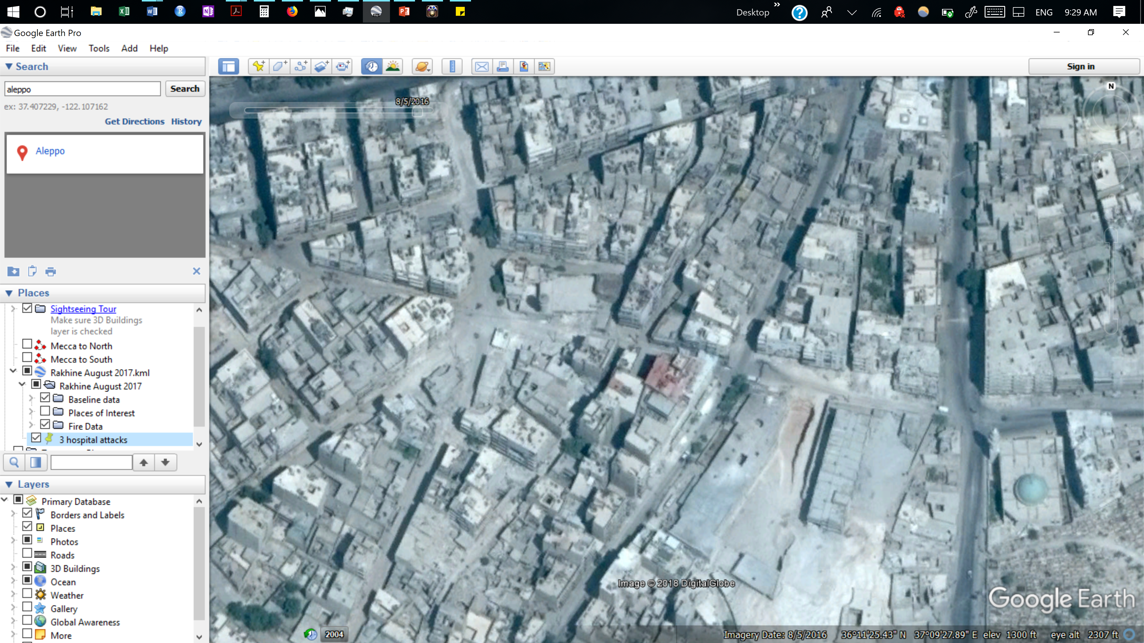
M2: 8/5/2016

Slide 8
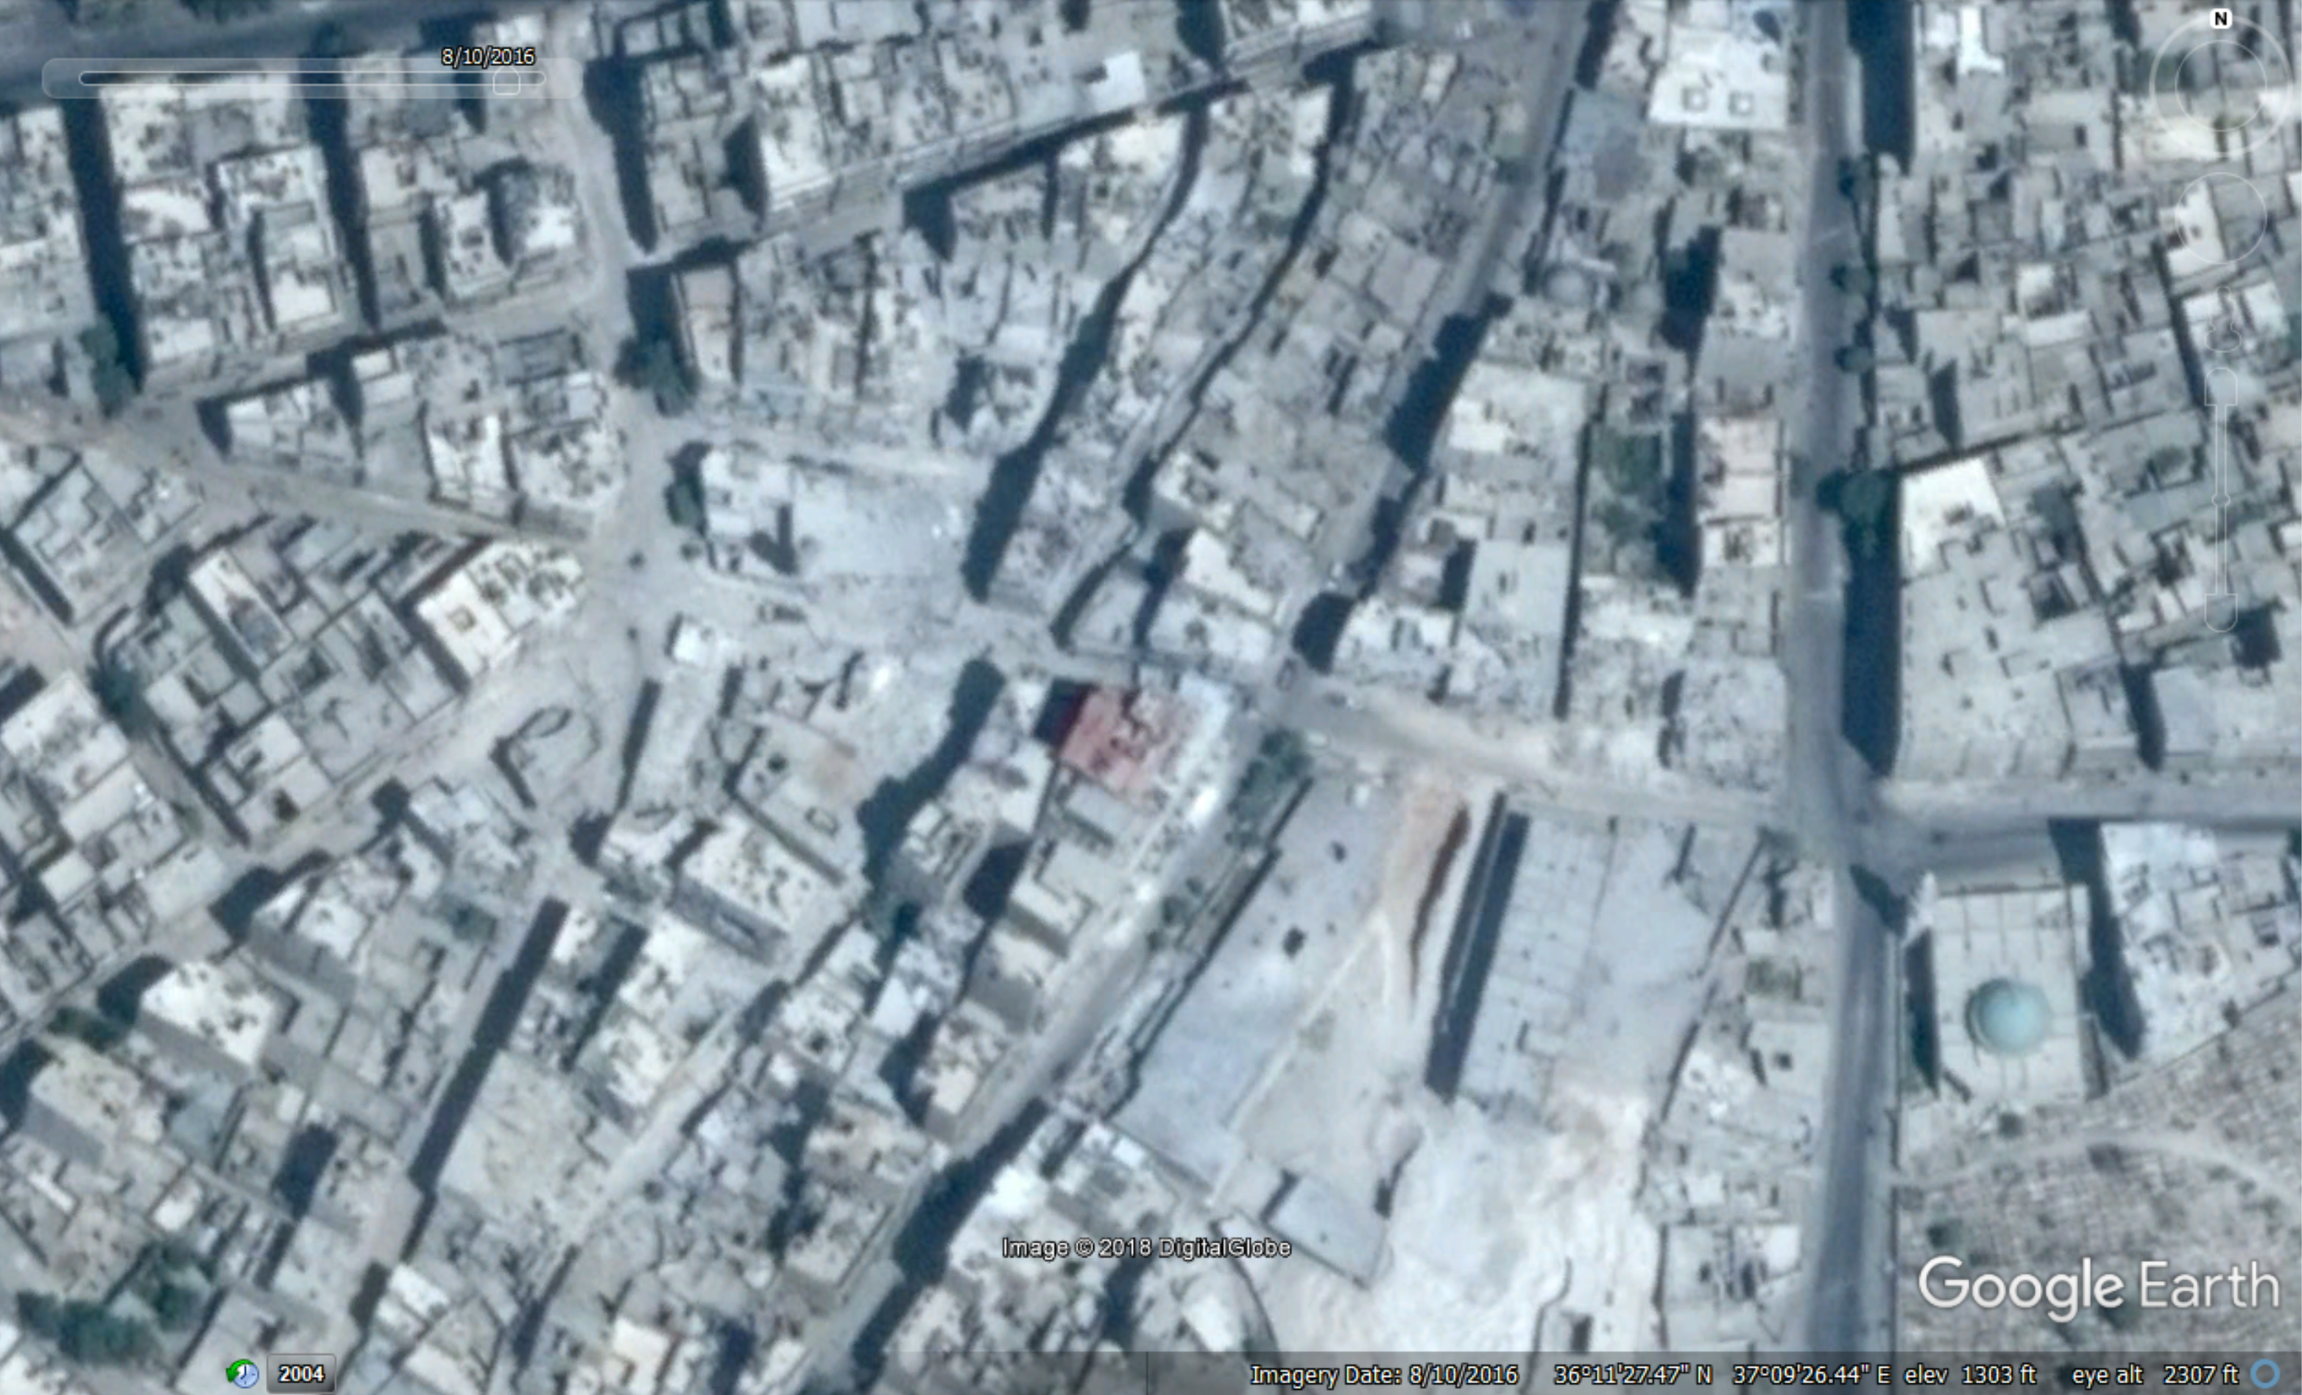
M2: 8/10/2016

Slide 9
M2: 8/10/2016

Slide 10
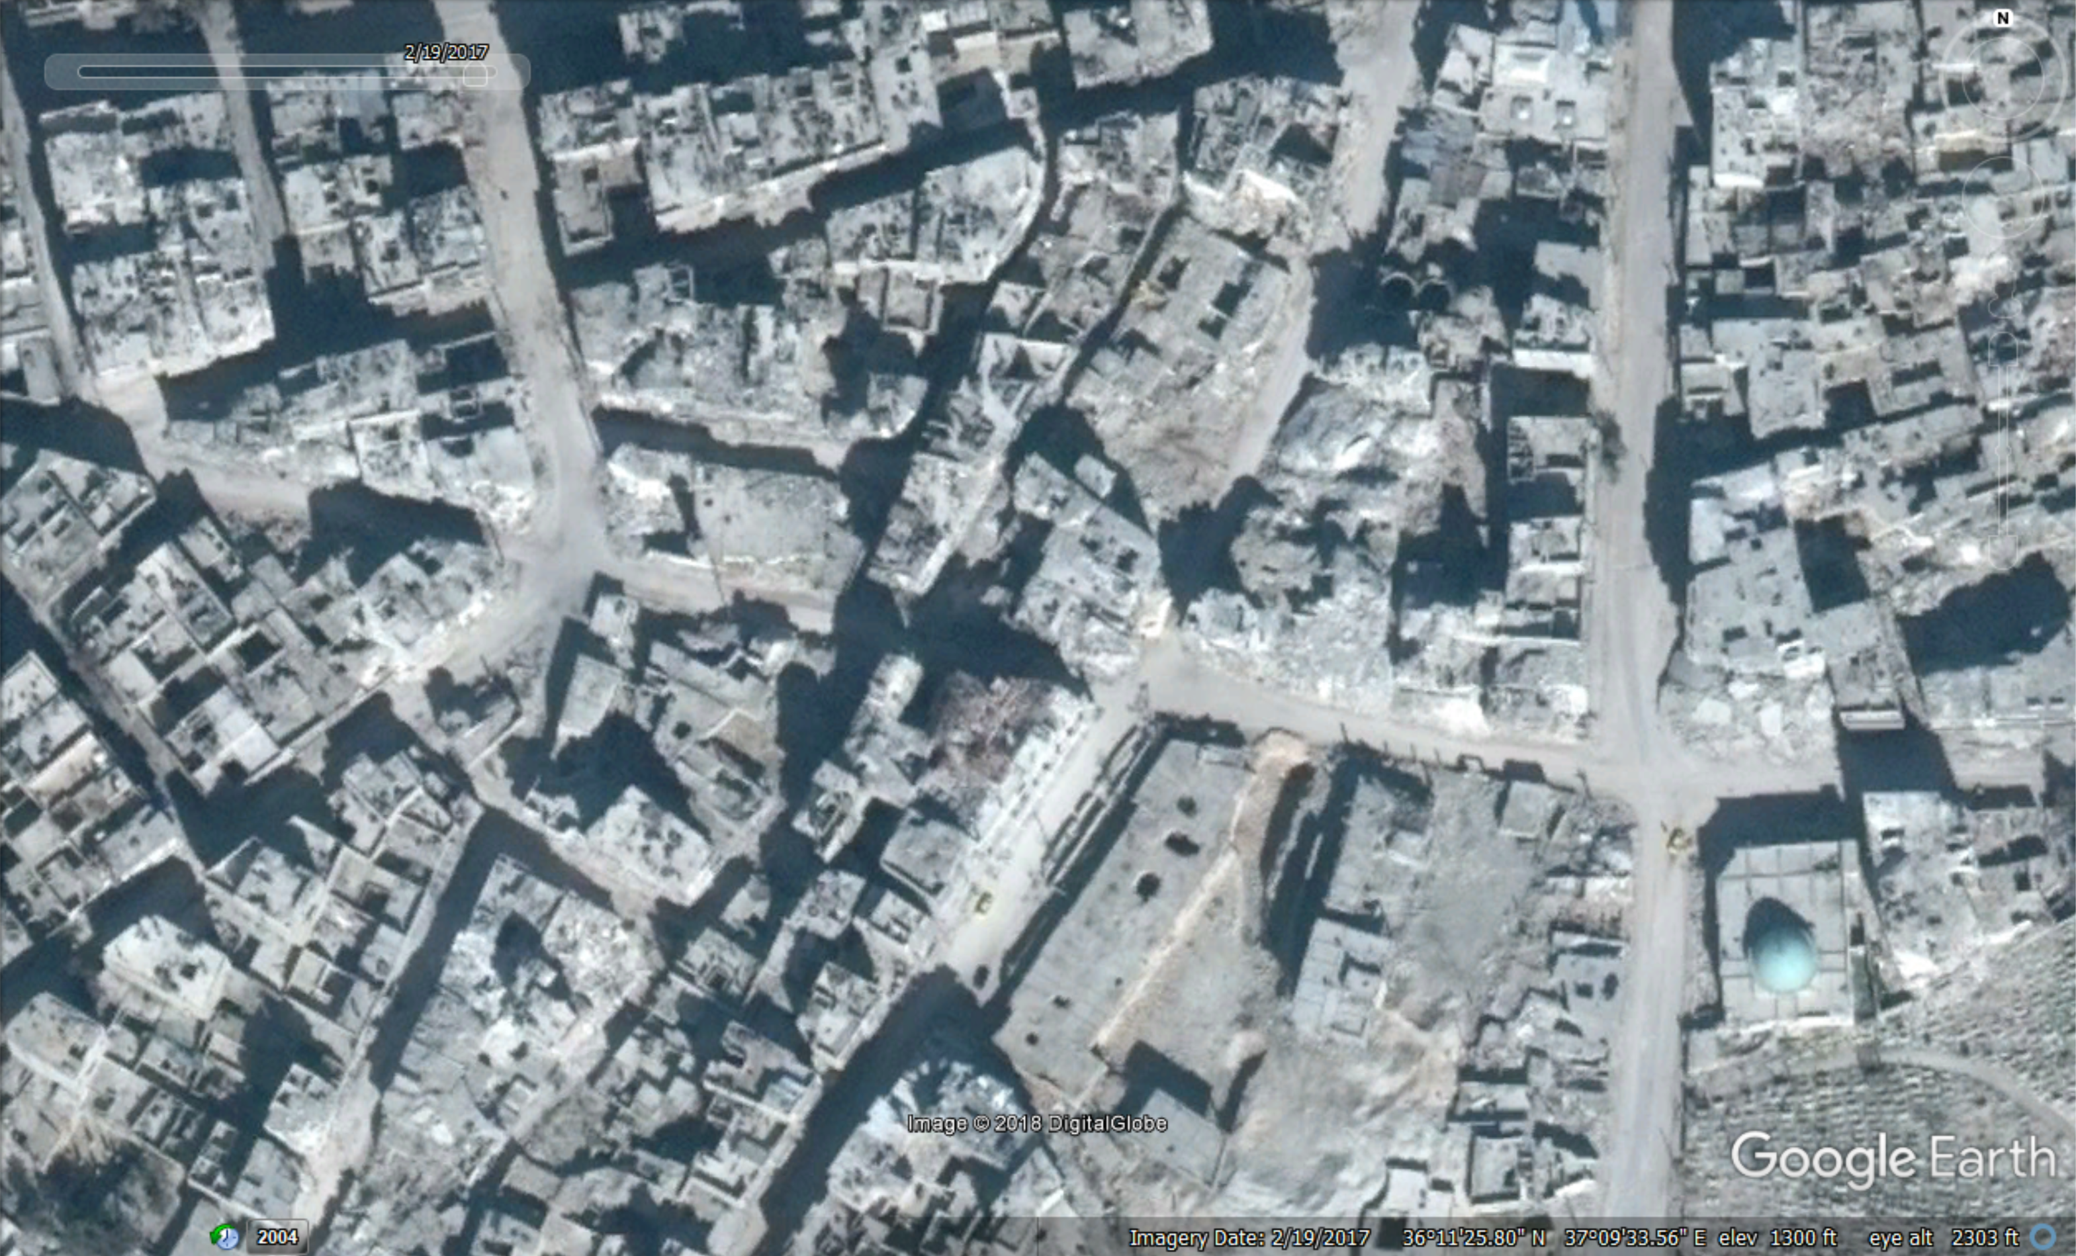
3 June 2016
14 June 2016
14 July 2016
16 July 2016
1 August 2016
5 August 2016
11 August 2016
23 September 2016
26 September 2016
28 September 2016
18 November 2016
4 December 2016
14 December 2016
M2: 2/19/2017
Notes:
Attacked 14 times in 6 months

Slide 11
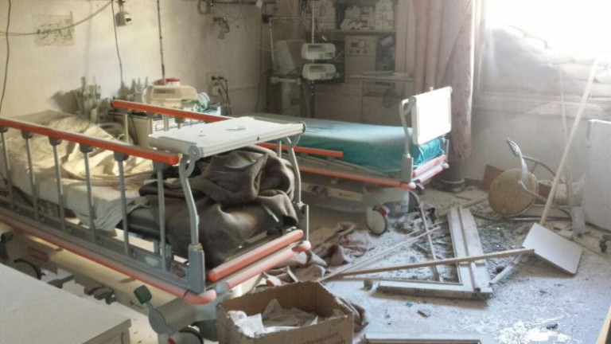
Courtesy of Union of Medical and Relief Organizations
According to SAMS: 14 Strikes from June to December 2016
Notes:
Need to rebuild: takes time, costs $$$, lost trust.
This is not just a loss of in-patient services, but of basic preventative needs like vaccinations

Slide 12
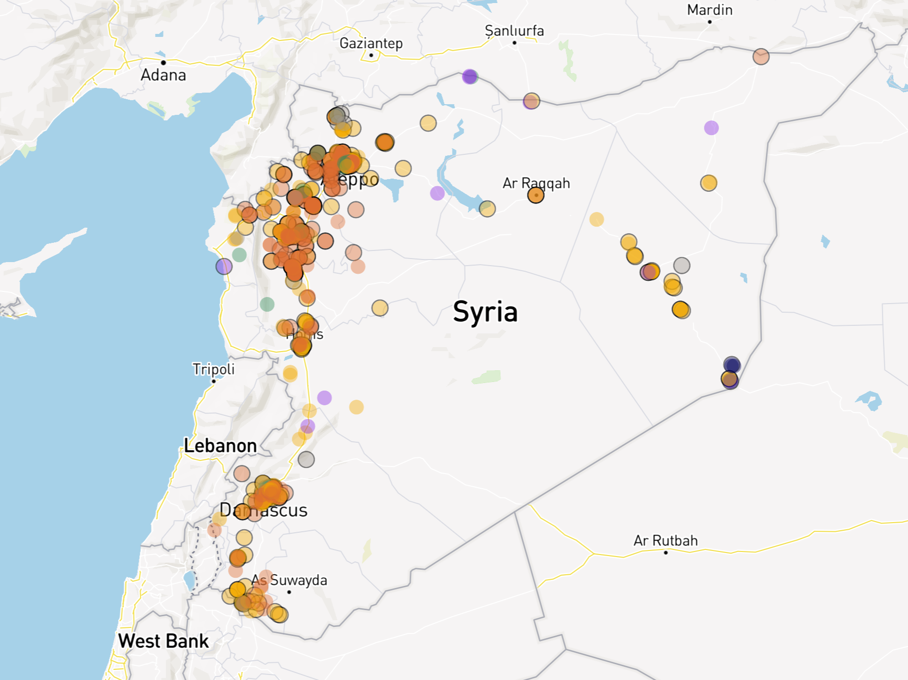
Notes:
(Test if it works better just here or both here and below)
-> Make it fit

Slide 13
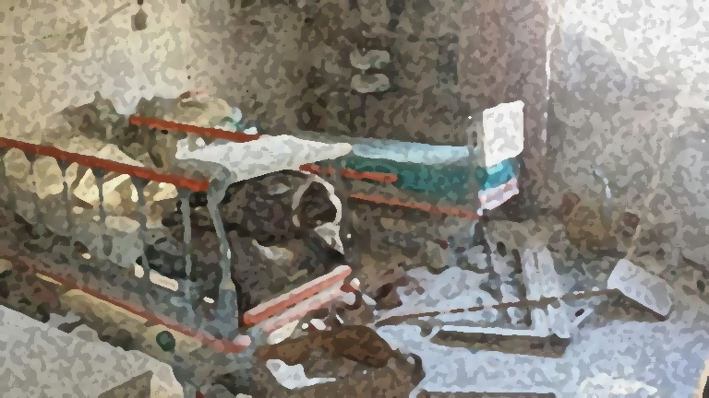
From Physicians for Human Rights:
Number of verified attacks: 550
Number of facilities targeted: 348
Health-workers killed: 891
32% doctors
23% nurses
19% medics
9% medical students, dentists, pharmacists, and veterinarians.
Causes of Fatalities:
Shelling and bombing: 54%
Small arms fire: 21%
Torture: 13%
Execution: 7%
Courtesy of Union of Medical and Relief Organizations
Notes:
Attacks on healthcare can include providers, facilities, equipment, medical supply chains, transportation.
Here, we are limiting the scope to facilities.

Slide 14
How has targeting healthcare in the Syrian conflict impacted infectious disease trends in northern Syria between 2015-2018?
Courtesy of Union of Medical and Relief Organizations

Slide 15

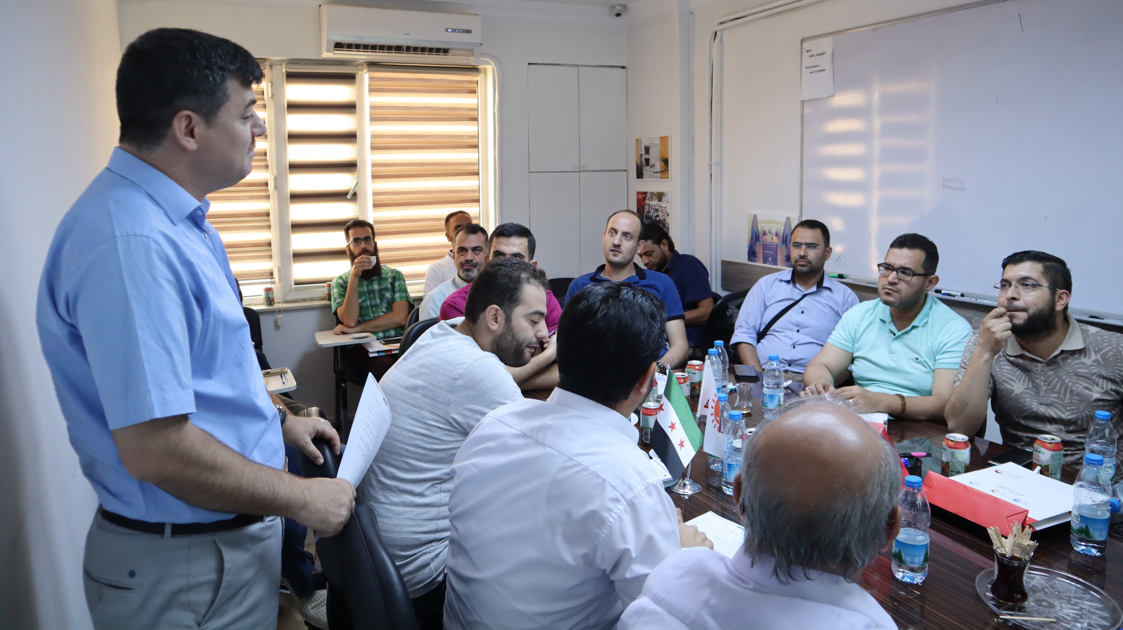
Training at the Assistance Coordination Unit (ACU), Gaziantep, Turkey

Slide 16
Structure of Surveillance
District Level Officers (DLO)
[District]
Community Level Officers
[Neighborhood]
Field Level Officers (FLO)
[Subdistrict]
Notes:
-Compete until end of 2018
-UN Office for the Coordination of Humanitarian Affairs
Active surveillance with zero-reporting
Started in 2013 in aftermath of the first polio (WPV-1) outbreak
Consistent and reliable weekly data flow from 2015 - Present
Dataset includes January 2015 – June 2018 (for now)
Population data from HNAP
Healthcare infrastructure attack data from Physicians for Human Rights (PHR)

Slide 17
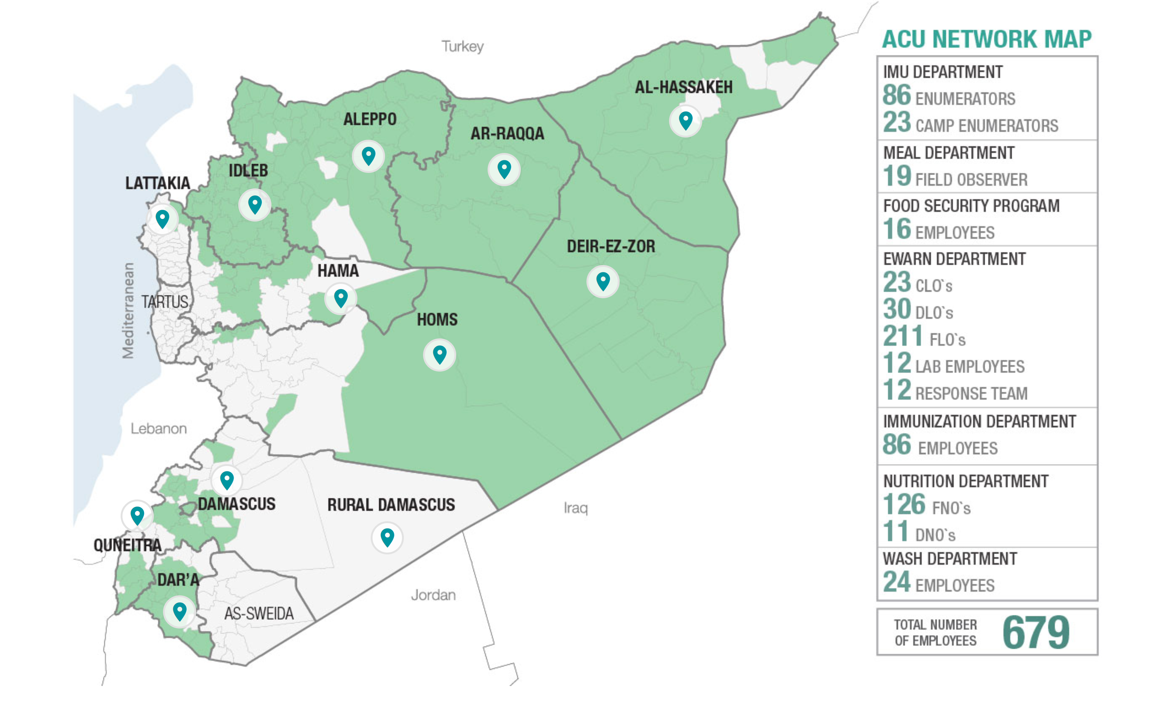
Coverage Map: Maximum Extent
x
x
x
x
Notes:
This is where the data captured in our dataset comes from
Since then, the ACU has lost access to many regions, since they operate in opposition controlled territories

Slide 18
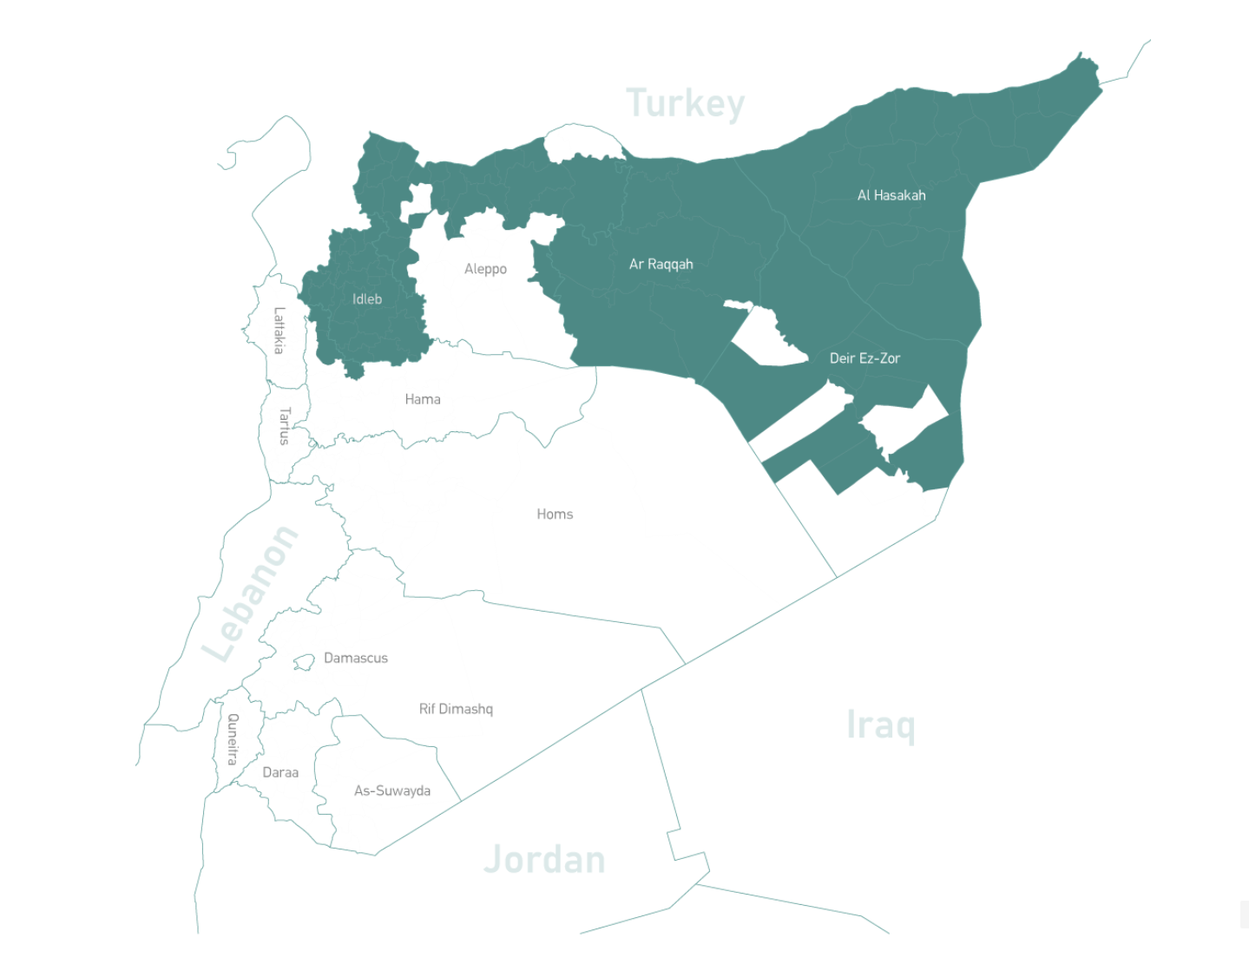
Coverage Map: 2019

Slide 19
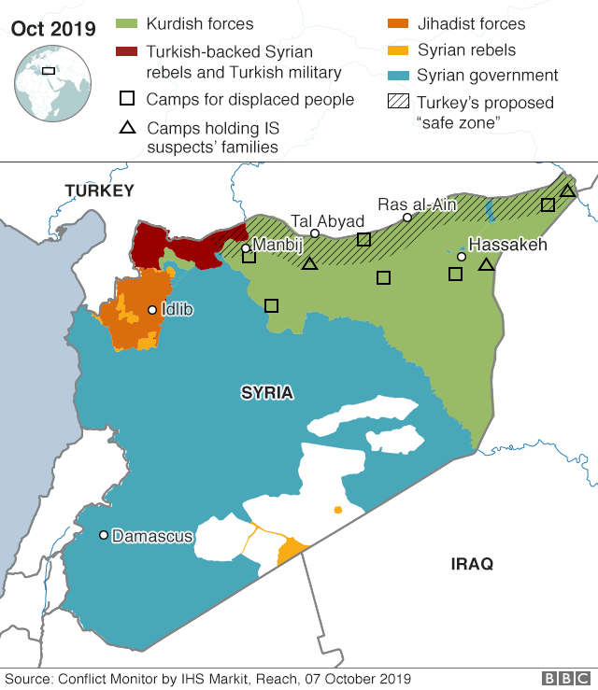
Notes:
The map now (April 2019). Syrian and Russian forces have gained the bulk of lost territory over the last year.
Red: Syrian government and its allies
Green: Syrian Opposition and its allies
Yellow: Democratic Federation of Norther Syria
-> clarify Turkish situation more recently
-> “popular in the media” but

Slide 20
Variables
Cases of 14 infectious disease syndromes + Total consultations
4.5 years of weekly reports between January 1st, 2015 and June 30, 2019
Stratified by sex (Female vs. Male) and age (≥5 vs. <5)
Stratified by governorate, district, and subdistrict
Population of districts between 2015-2019 collected monthly
Attacks on facilities 2011 - 2018
PHR dataset, includes date of attack
Stratified by district, method of attack, alleged perpetrator of attack
Notes:
-> Focus on your dataset.
-> say that this is broader dataset

Slide 21
Why Measles?
High number of cases
Well-suited for clinical diagnoses
Baseline prior to conflict: was eliminated
One of the most infectious disease known
Sentinel disease: sensitive to drops in vaccination rate
Notes:
-> # of total measles
-> relate it to US/north American/Europe outbreaks, small gaps here lead to outbreaks

Slide 22
Weekly Incidence of Measles by Governorate January 2015 – June 2019
Notes:
-> what do you want the audience to get from it

Slide 23
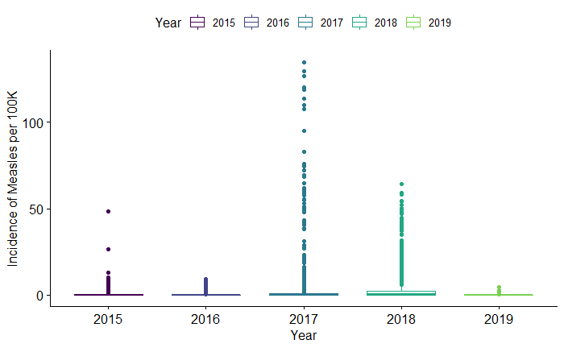
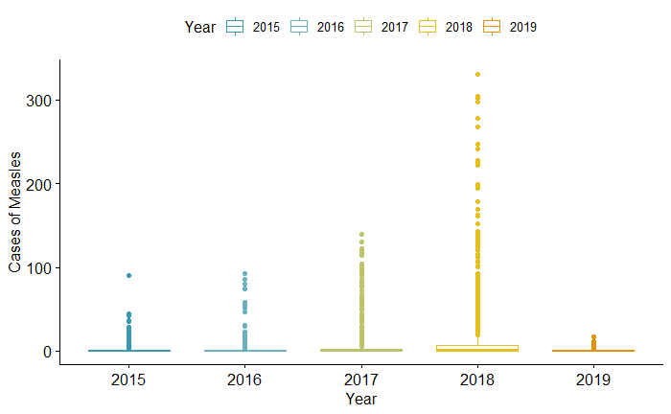
Suspected Annual Incidence of Measles
Suspected Annual # Cases of Measles
Notes:
Each dot represents a district.
Incidence represents the number of cases per 100,000 people each year.
Before we saw spikes in incidence between governorates, but within governorates there are large differences.
Even though many districts had higher levels of incidence in 2017 than in 2018, the total number of cases was actually higher in 2018 because the outbreaks were in more populated regions.
The bottom chart shows us which districts were most effected, and when: each bar represents the total number of cases in a given year.
-> describe low incidence to high incidence, absolute vs incidence
-> need oneliner on the difference between incidence and absolute cases
-> thing point about children

Slide 24
Show me the p-values:
Results from Pairwise
Wilcoxon Rank-Sum Test
Wilcoxon rank sum test of Incidence by Governorate | Al-Hasakeh | Aleppo | Ar-Raqqa | Dar’a | Deir-ez-Zor | Hama | Homs | Idleb
Aleppo | <0.001 | - | - | - | - | - | - | -
Ar-Raqqa | <0.001 | <0.001 | - | - | - | - | - | -
Dar’a | 0.0682 | <0.001 | <0.001 | - | - | - | - | -
Deir-ez-Zor | <0.001 | <0.001 | <0.001 | <0.001 | - | - | - | -
Hama | <0.001 | <0.001 | <0.001 | <0.001 | <0.001 | - | - | -
Homs | <0.001 | <0.001 | <0.001 | <0.001 | <0.001 | <0.001 | - | -
Idleb | <0.001 | 0.018 | 0.0180 | <0.001 | <0.001 | <0.001 | <0.001 | -
Quneitra | 0.287 | <0.001 | <0.001 | 0.0374 | <0.001 | <0.001 | <0.001 | <0.001
Notes:
Non-parametric data: not normally distributed.
For the Wilcoxon test, a p-value is the probability of getting a test statistic as large or larger assuming both distributions are the same
“does not estimate the difference in medians (a common misconception) but rather the median of the difference between a sample from x and a sample from y.”

Slide 27
Annual Incidence of Suspected Measles in Syria: 2017
Annual Incidence of Suspected Measles in Syria: 2018
Notes:
This is all coming from context of war
Areas under government control have, for the most part, retained some access to public health services and surveillance.
What’s crazy about this is that this was a grassroots effort by Syrian physicians, that garnered support from international organizations such as the WHO, B&MGF, and even the CDC, and has produced data that, as one study showed, is likely more accurate than estimates from the governmental surveillance efforts.
Challenges what is possible to study in conflict, and the very reliability of information in a war torn setting, all that in a conflict that has been plagued by misinformation and propaganda.

Slide 29
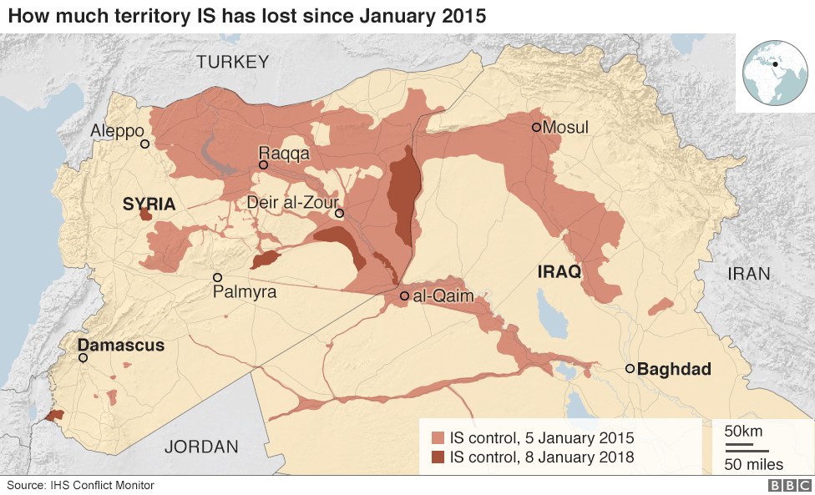

Slide 30
Challenges & Limitations
Not all cases of measles present to a clinical setting
“Attacks” limited to attacks on facilities
No assessment of sensitivity of clinical findings
Difficult to disentangle other effects of conflict on public health
Impact of conflict on integrity of data collection
Limited access to many regions
Dynamic population

Slide 31
Opportunities
Unique:
No published literature that incorporates such rich data across all of these years of the conflict
One of the best documented conflicts in human history
Potential to contribute to models for surveillance and research in conflict
Necessary:
Advocacy
Accountability
Basic Human Rights

Slide 32
Potential Implications
Hypothesis Generation
Associations between attacks on healthcare or other major milestones of the conflict and infectious disease trends can guide us to target future research
Programmatic Guidance
Building our understanding of potential impacts on infectious diseases can help us preemptively respond in future crises
Understanding regional vulnerability to vaccine preventable diseases or waterborne illnesses can help inform future vaccination campaigns or sanitation projects
Advocacy
Documenting public health effects of conflict is critical for accountability
Maintain awareness of the broader and long-term impact that war and war crimes can have
Empower local NGOs and support their crucial efforts
Notes:
Hypothesis Generation
Associations between attacks on healthcare or other major milestones of the conflict and infectious disease trends can guide us to target future research
Programmatic Guidance
Building our understanding of potential impacts on infectious diseases can help us preemptively respond in future crises
Understanding regional vulnerability to vaccine preventable diseases or waterborne illnesses can help inform future vaccination campaigns or sanitation projects
Advocacy
Documenting public health effects of conflict is critical for accountability
Maintain awareness of the broader and long-term impact that war and war crimes can have
Empower local NGOs and support their crucial efforts

Slide 33



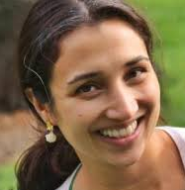
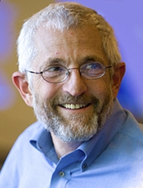
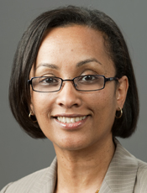
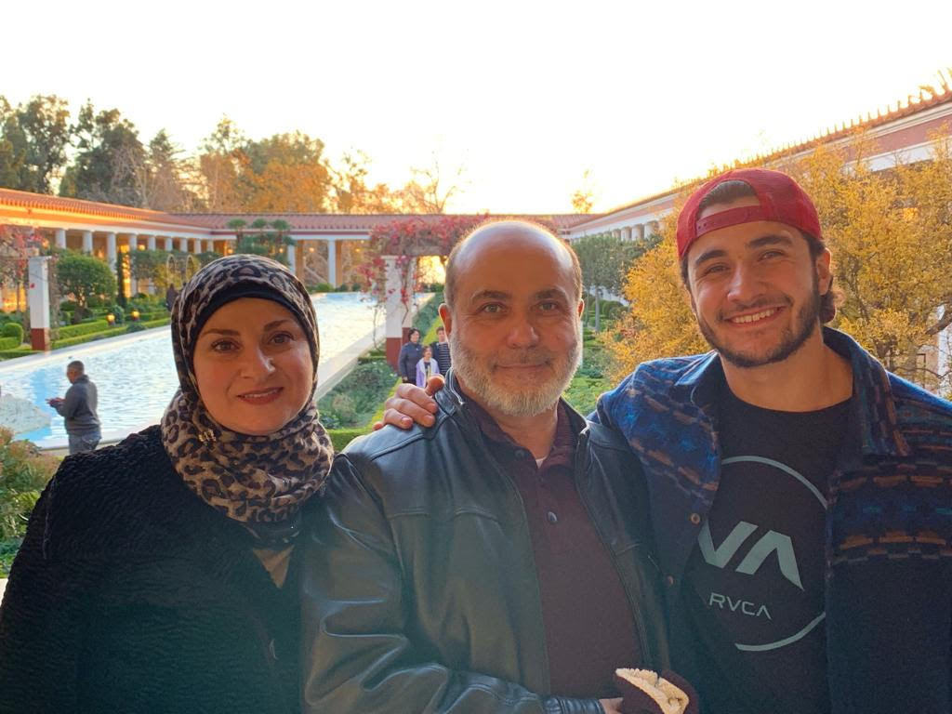
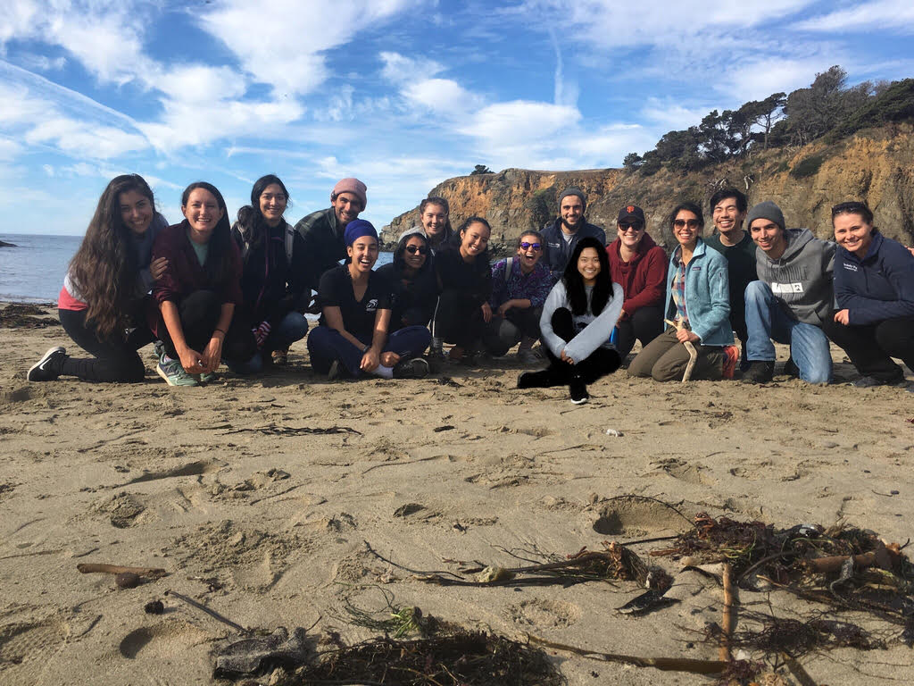
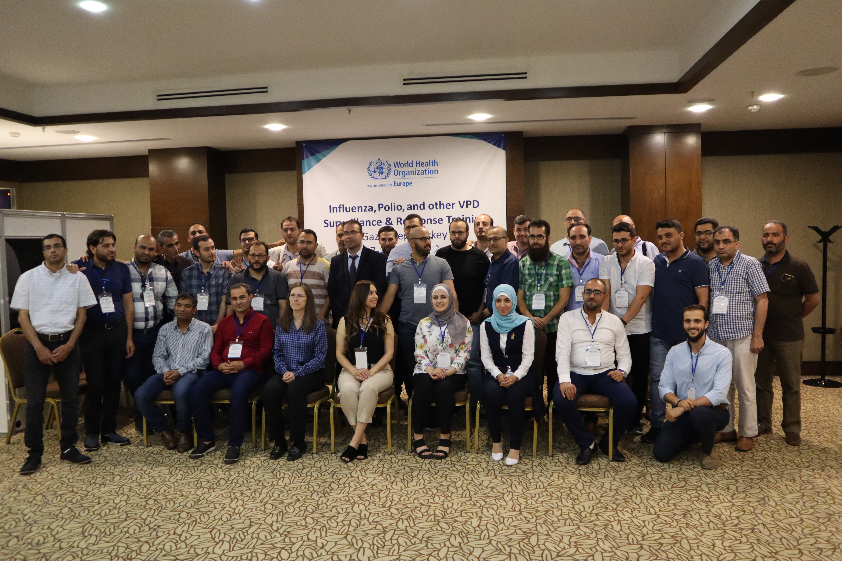
Special Thanks

Slide 34
Special Thanks
Dr. Rohini Haar
Dr. Arthur Reingold
Dr. Ndola Prata
My Family
My Friends
The Unrecognized Heroes on the Ground

Slide 35
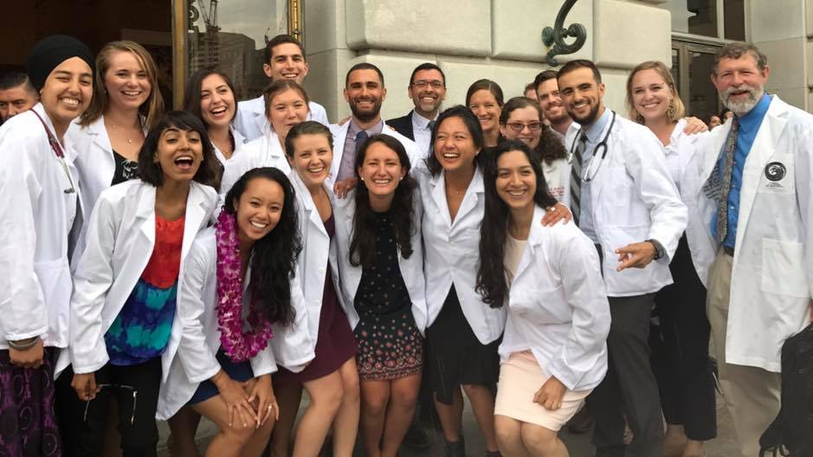
Thank You!
Notes:
Talk more about thesis:
What data do you have
What do you plan to do with the data
What are future implications of the data
How future people can benefit
Ended where I should start.
Start with what your ultimate goal is, and what your variables are, tell them why you’re going to all this info
Comparing model against other wars without conflict, comparing baseline to other countries average or to Syria’s baseline
Focus less on limitations, more positive spin: despite limitations, here are our contributions. Unique opportunity.
A general outline of WIPs (but only if this fits your topic) would be:
Title slide with your name and your affiliation (JMP)
Acknowledgements slide (at the beginning OR at the end—this should be BRIEF and reasonable. Your kindergarten teacher probably DOES deserve credit, but probably not today)
(Outline of talk)—Only if you have an overview that really describes your talk, not a list of the sections below!!
Background—This will be an important part of your talk at this stage. It should lead directly to “e” below.
Research question or area of interest (if RQ not appropriate)
(Hypotheses)—if applicable
Methods:
Sampling and recruitment
Variables
Data collection
Analysis
Preliminary Results—IF APPLICABLE
Limitations (what are the weaknesses of the research, particularly those that may have biased the findings)
Timeline and next steps
Lessons learned (for the 1st years, also optional)
Questions for the audience (optional)

